Slide 1


Social Media: Targeting, Reconnaissance, and Exploitation
Aaron Barr
CEO
Aug 9, 2010

Slide 2
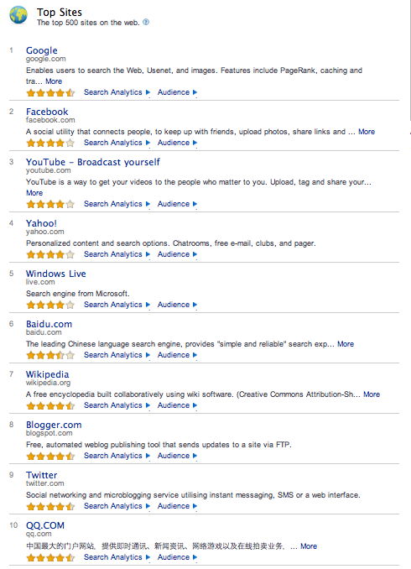
Search vs. Social
With the exception of Google, the top 20 sites predominately are social media based.

Slide 3
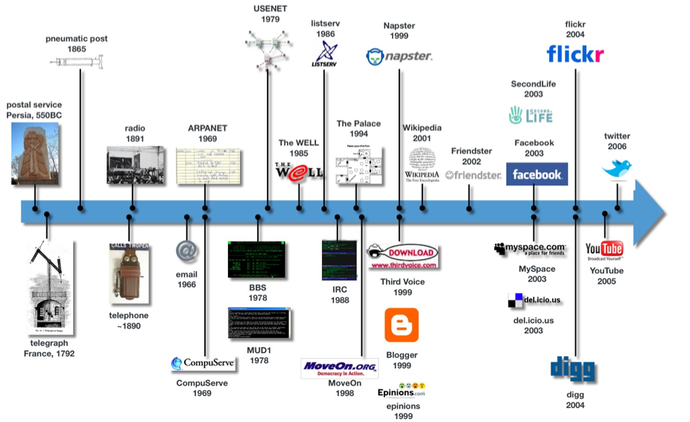






Evolution of Social Media
Social Media Timeline
Google Buzz
2010
Foursquare
2009

Slide 4
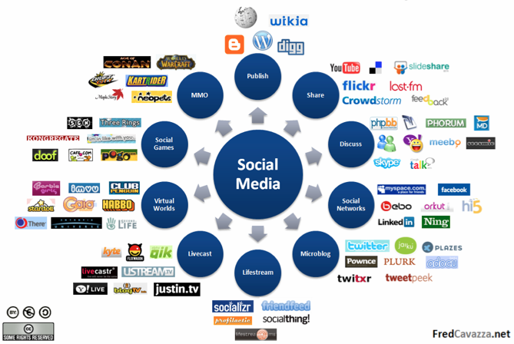



Social Media Breakdown
LBS

Slide 5
Why Social?
Personalizes user experience. Provides tailored information and fosters engagement.
Social Media filters web content based on PII to provide you with tailored information and services.
Provides information that regular searches are not well equipped to provide.

Slide 6
Social vs. Search
Search can provide a restaurants location and contact information, or a menu. Social provides restaurant reviews and recommendations.
Search tells you where to buy jeans. Social tells you whether or not other people like or dislike those jeans and why?
Its about personal relevance…

Slide 7
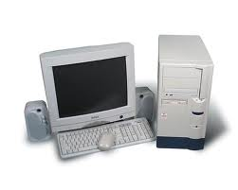
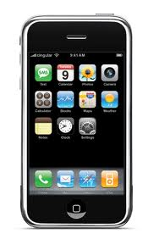
Framework of the Web
STATIC
SOCIAL
REAL-TIME
GEO-LOCATED
G
F
T
Fading
Perimeter
Adhoc
Networks
Cloud

Slide 8





Content Aggregation
150 Networks control 50% of all Internet traffic.
30 Companies account for 30% of all Internet traffic.
Google alone accounts for 6%.

Slide 9
Social is King
60% of Web users visit social networks.
Facebook: 598M unique visits a month.
Youtube: 425M unique visits a month.
Windows Live: 140M unique visits a month.
Twitter: 96M unique visits a month.
Myspace: 95M unique visits a month.
6.8% of business traffic goes to Facebook. 10% goes to Youtube.
Notes:
http://www.socialnetworkingwatch.com/all_social_networking_statistics/

Slide 10
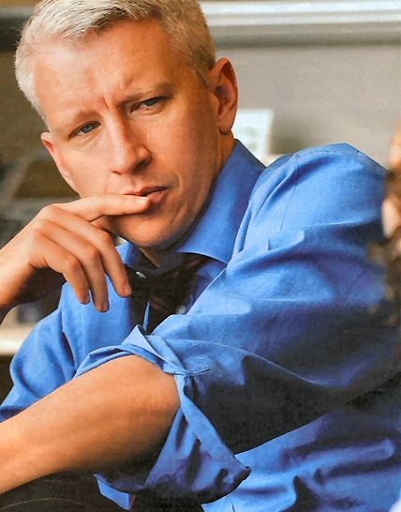

Growth of Amateur Content
An amateur voice of thousands is more responsive and accurate than the trained voice of one.
More choices to select the voices of interest.
Wikipedia is more accurate than encyclopedia Britannica
Notes:
http://www.socialnetworkingwatch.com/all_social_networking_statistics/

Slide 11
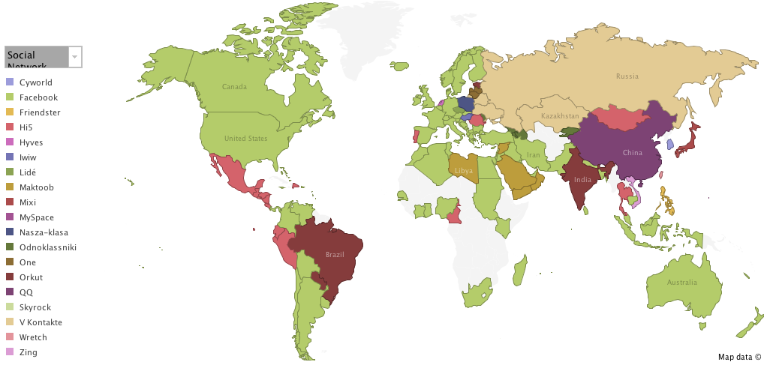
Global Top Social Networks

Slide 12
Video is King
30 Billion videos watched online in the US in April with the majority from Google sites.
Currently 35% of internet traffic is video.
Historically video consumption grows at 70% annually.
Estimates as high as 60% of Internet traffic will be video by 2013.
This doesn’t account for gaming.

Slide 13
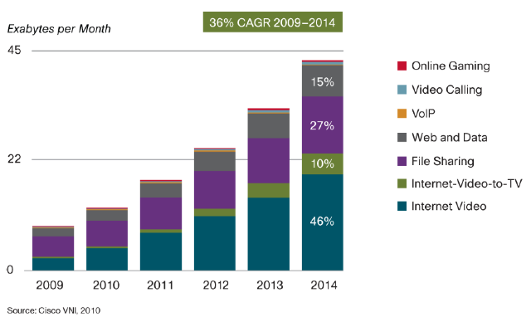
Video Projections
Notes:
http://www.cisco.com/en/US/solutions/collateral/ns341/ns525/ns537/ns705/ns827/VNI_Hyperconnectivity_WP.pdf

Slide 14
Online Gaming
In 2008 video game sales surpassed movie sales.
In 2009 traditional game sales declined, while digitally delivered casual game sales skyrocketed.
iPhone/iPad/Android and SNS Social Gaming is starting to drive the market.
Virtual goods sales surpassed $1B in 2009.

Slide 15
Mobile is King
74% of U.S. adults use the Internet
55% of U.S. adults connect through wireless
25% of U.S. adults use Mobile Apps
Mobile Social Networking grew 240% in 2009.
Driving information and services as you live

Slide 16

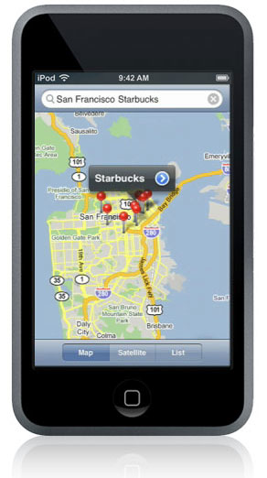







Location Based Services
Hyper-targeting based on preferences and location will change the perception on the release of PII.
If a service can tell you that what you want is on sale right around the corner your going to opt in.

Slide 17

Privacy Concerns Fade
When Walmart starts offering 20% off specially marked goods for checking in using Facebook Places.

Slide 18
Other Technologies
Convergence
Object and Facial Recognition.
Audio to Text
Augmented Reality
Drive toward real-time user experience.

Slide 19
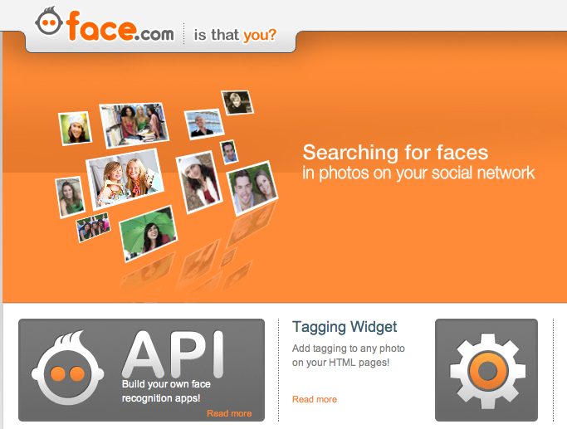
Face Recognition
Migration to implicit rather than explicit release of PII. Your in the background of a photograph and can be automatically identified.

Slide 20
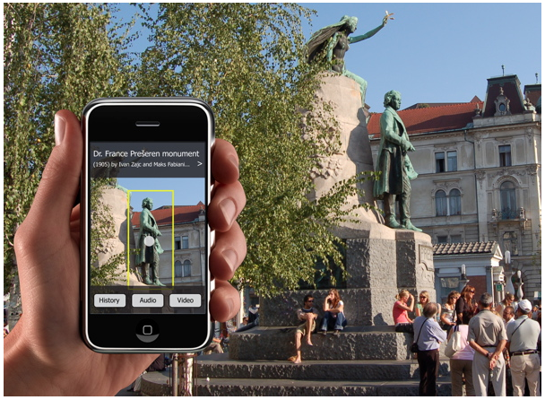
Object Recognition
Advancements in this space can not only tell whose in the photograph but where they are.

Slide 21
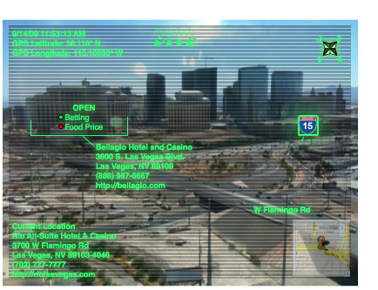
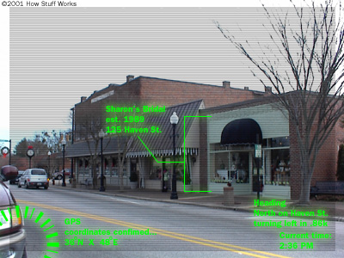
Augmented Reality
Location-based services, object recognition, and SNS consolidation
Real-time, Geo-located web

Slide 22
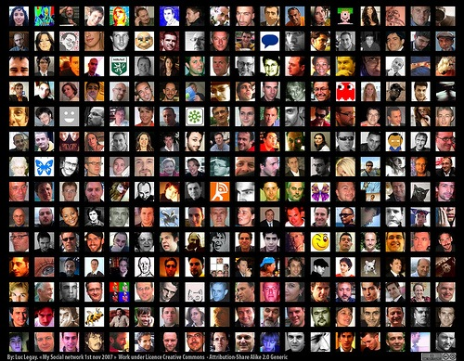
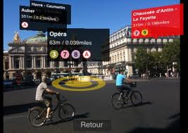

Future Web
Social
Visual
Mobile

Slide 23
Privacy vs. Content
The amount of exposed PII will increase dramatically to further personalize content.
The aggregation of PII across Social Media Platform is the real concern.
Privacy is a receding tide.
Notes:
http://www.bnet.com/2403-13070_23-219914.html

Slide 24

Privacy vs. Content
Facial Recognition
Speech to Text
Object Recognition
Notes:
http://www.bnet.com/2403-13070_23-219914.html

Slide 25
SM Vulnerabilities
Social Media is the single most effective resource when developing targeted attacks.
There is no firewall, no anti-virus program for wet ware (human brain).
Little or no capability to monitor and protect against in service content and the aggregation PII.
How can you tell the difference between a legitimate program collecting information to drive content vs. malware? (Infoware)
Notes:
http://www.bnet.com/2403-13070_23-219914.html

Slide 26
Targeting
The more information about an individual or an organization that is available the easier it is for an adversary to develop a clearer operational picture and find easy points of entry.
Individuals can be easily identified to a particular company, profession, etc.
Notes:
http://www.bnet.com/2403-13070_23-219914.html

Slide 27
Link Analysis
The more you interact online and expose relationships the easier it is for an attacker discern hidden details about an individual and develop exploitation paths.
Notes:
http://www.bnet.com/2403-13070_23-219914.html

Slide 28




Link Analysis
A competitive intelligence capability that took inputs from these four services.
Conducting time and data correlations of RFP release, job postings, contract awards, and profile modifications you could tell who won what contracts and who is working on them.
Notes:
http://www.bnet.com/2403-13070_23-219914.html

Slide 29
Exposure of Information
Don’t assume someone is who they say they are.
Don’t assume your information is protected even if your privacy and security settings are tight.
Consider cross platform analysis
Consider embedded data (GPS, other)
Notes:
http://www.bnet.com/2403-13070_23-219914.html

Slide 30













LinkedIn Groups

Slide 31
Exploitation
Links, Posts, Apps – all can contain links to malicious content that can exploit a system.
These can easily and likely will come from friends
The rise of social media and amateur content creates an opportunity for lots of unvetted content.
Ebay
Facebook Marketplace or pages
Notes:
http://gucosc011.blogspot.com/2010/10/some-android-apps-caught-covertly.html

Slide 32
Unintended Consequences
Once you post it exists for better or worse. Think about the longevity of your information.
Examples of employment, insurance, relationships have been effected or compromised based on social media information.
Notes:
http://www.bnet.com/2403-13070_23-219914.html

Slide 33
Social Media Recon
Social media provides a wealth of personal and organizational information that when analyzed in aggregate can be quite informative.
Some easy analysis techniques.
Facebook – social link analysis can expose information about partnerships, personal history.
Twitter – what themes are re-ocurring. Where you get your news and personal beliefs. Personal linkages.
Linkedin – Professional background and experience.
Forums – Hobbies, challenges
Notes:
http://www.bnet.com/2403-13070_23-219914.html

Slide 34
Facebook Statistics
Sophos conducted an experiment in late 2009, and started friending random people.
46% accepted
89% divulged their full birthdates
50% town of residence
Notes:
http://www.bnet.com/2403-13070_23-219914.html

Slide 35
Use Cases

Slide 36
Social Media Recon 101
Who is the target?
Defense, Commercial, Government
Characterize the organization and personnel
What to create?
pages
personas
Hometown, High school, College, Jobs
Likes/dislikes, hobbies?
Movies, Music, Quotes, Books, Activities
Build up and in towards your target.

Slide 37
Background Research
Tell me where current military mobile commands are.
http://www.navy.mil/navydata/navy_legacy_hr.asp?id=146
http://www.strategypage.com/fyeo/howtomakewar/databases/wherearethedivisions.asp
Object recognition. Troll public photos for specific objects (landmarks, logos, etc.)

Slide 38
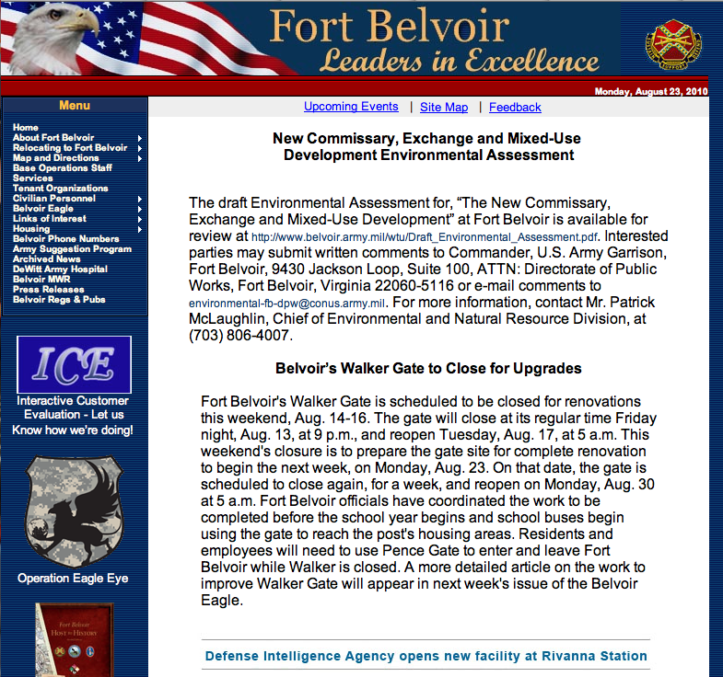
Organization website
Landing pages provide information about the org. and current events.
Use this information in social media space to legitimize profile and create conversation.

Slide 39
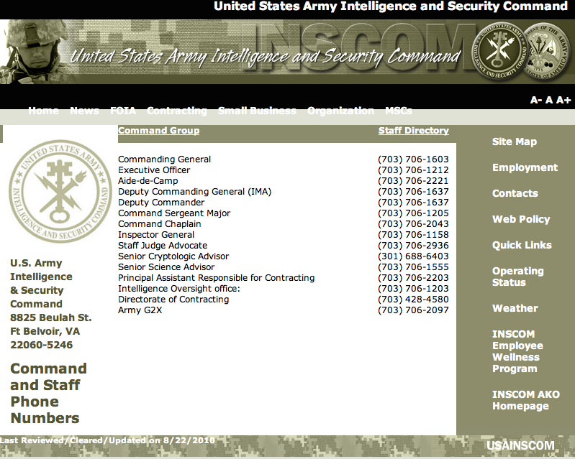
Build a Personnel DB
Contact sheets will give me people to call to get bits of information.
Google searches:
@domain.com
(703) 706-
Site: domain.com

Slide 40
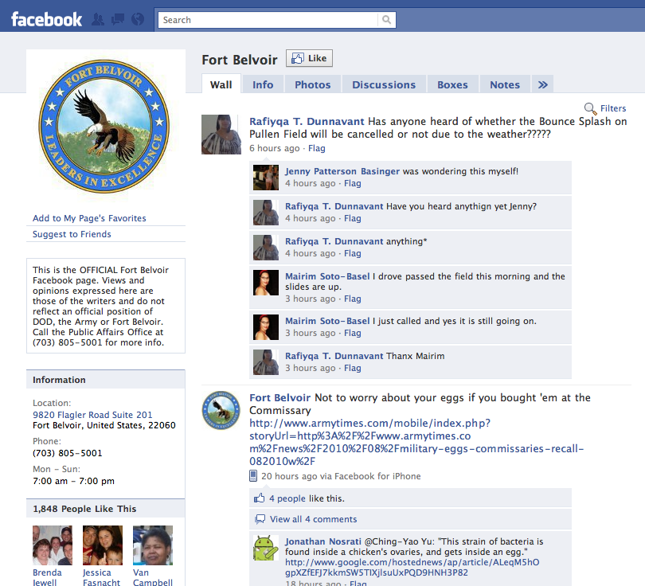
Facebook Pages
Most organization have Facebook pages that provide current information.
Place to perform recon, engage and form connections

Slide 41

Facebook Pages

Slide 42
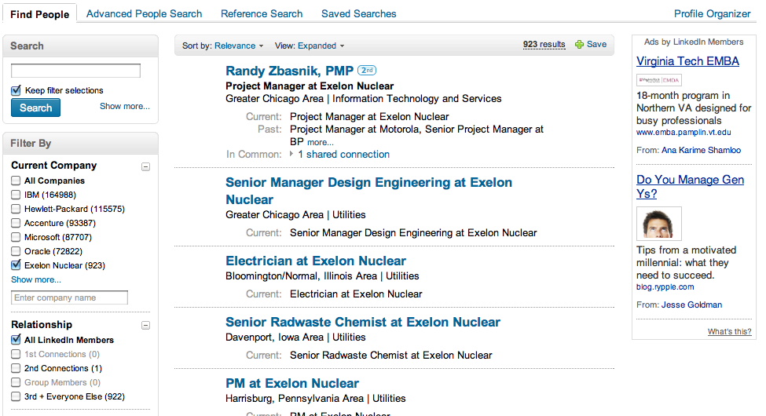

Slide 43
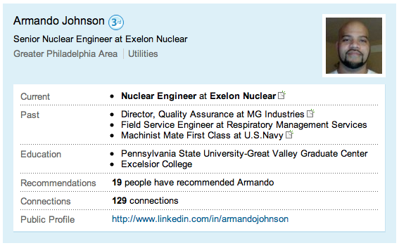

Slide 44
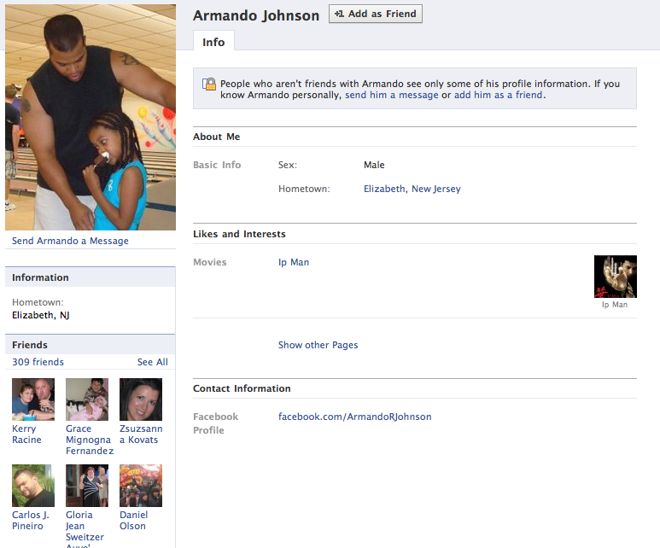
Facebook Link Analysis
12 Exelon Friends
Link analysis to find the others
From: Dayton, OH

Slide 45
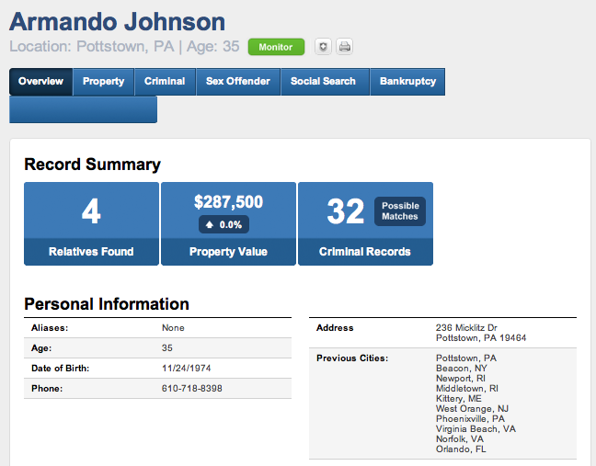
Background Check
Relatives:
Angela Johnson (wife) maiden Williams
K – 16
DJ – 11
AJ - 4
Theresa Lynn Johnson (40)
Reginald Lynn Johnson (44)
Lavonda Michelle Johnson (42)

Slide 46
Maps
Relatives:
Angela Johnson (wife) maiden Williams
K – 16
DJ – 11
AJ - 4
Theresa Lynn Johnson (40)
Reginald Lynn Johnson (44)
Lavonda Michelle Johnson (42)

Slide 47
Link Analysis
Exelon
Adam Donell
Allan Charles
Allen Columbus
Andrew Krukowski
Andrew Yawger
Andy Oswald
Bob Lance
Brandon Shultz
Celena Cook Banks
Declan Doran
Giselle D. Martinez
John Yurasits (Janos)
Julie Gundrson-Mihm
Michael Holmes
Rebecca Higgins
Tara Freeman Myers
He has ties to:
OH, NJ+, AL
Navy – Prob. Where he learned to be a nuke
Angela 고은 Jeon

Slide 48

Company ABC
Employee1
Employee2
Sensitive Customer
Company XYZ

Slide 49








Associations
Knowledge
Interests
Expertise
Associations
Employer
Work History
Memberships
Associations
Interests
Likes
Associations
Location
Habits

Slide 50
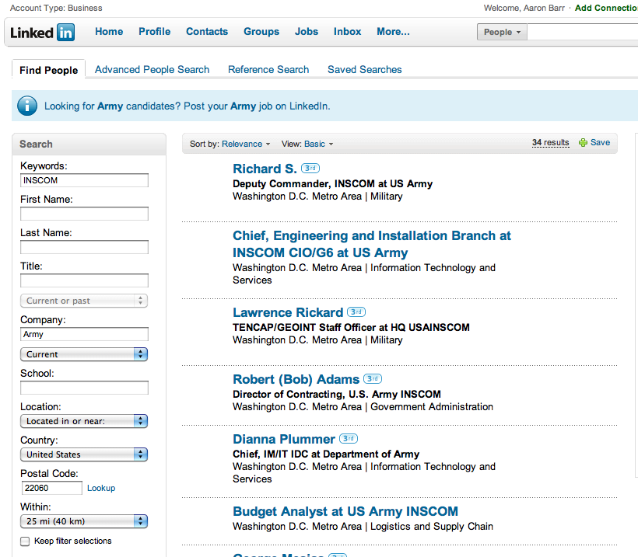
Linkedin Searches
Search for people associated with organization.
Search for all Smart Grid engineers that work for PECO in PA – no problem.
Search for INSCOM in zip 22060.

Slide 51
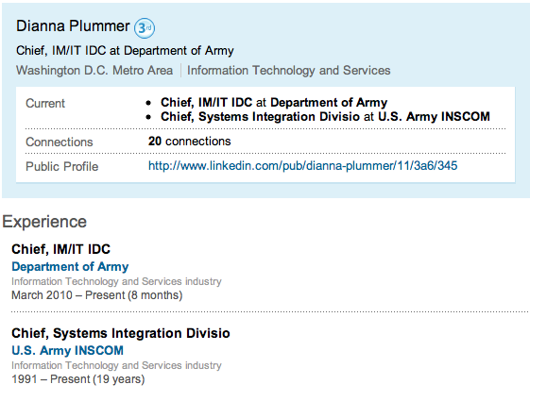
Linkedin Searches
More than enough information to start.
Known:
Name
Position
Location
Organization
Experience
Connections

Slide 52
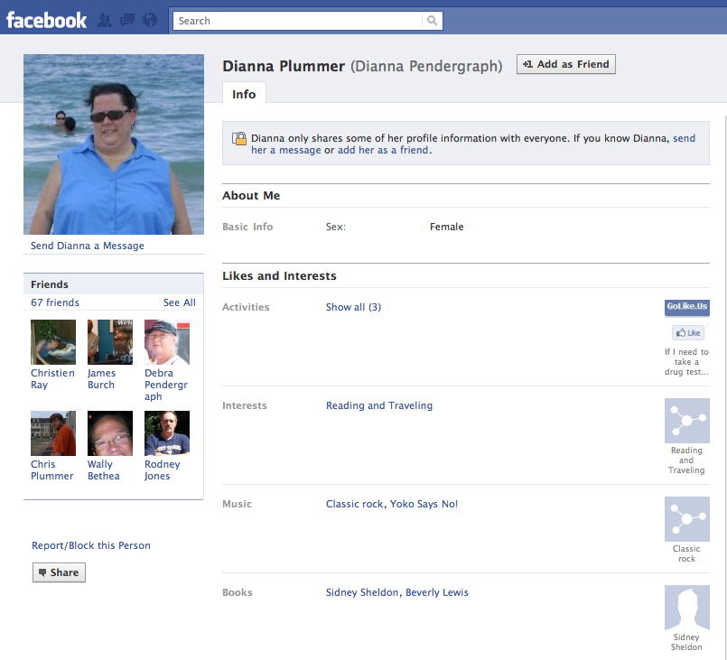
Facebook Profiles
Start to collect information on individuals within the organization
Focus on easy targets
SN link analysis and mapping

Slide 53
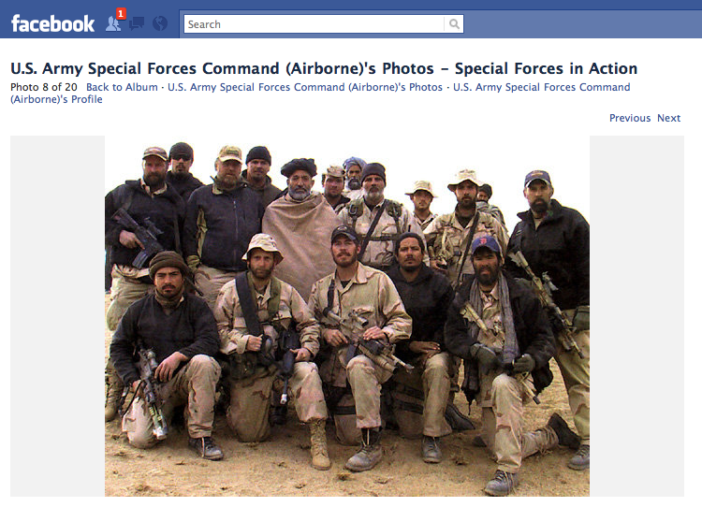
Whats in a Picture?
Interesting photo of U.S. special forces with Hamid Karzai
Embedded GPS
Facial recognition
Context
Associations

Slide 54
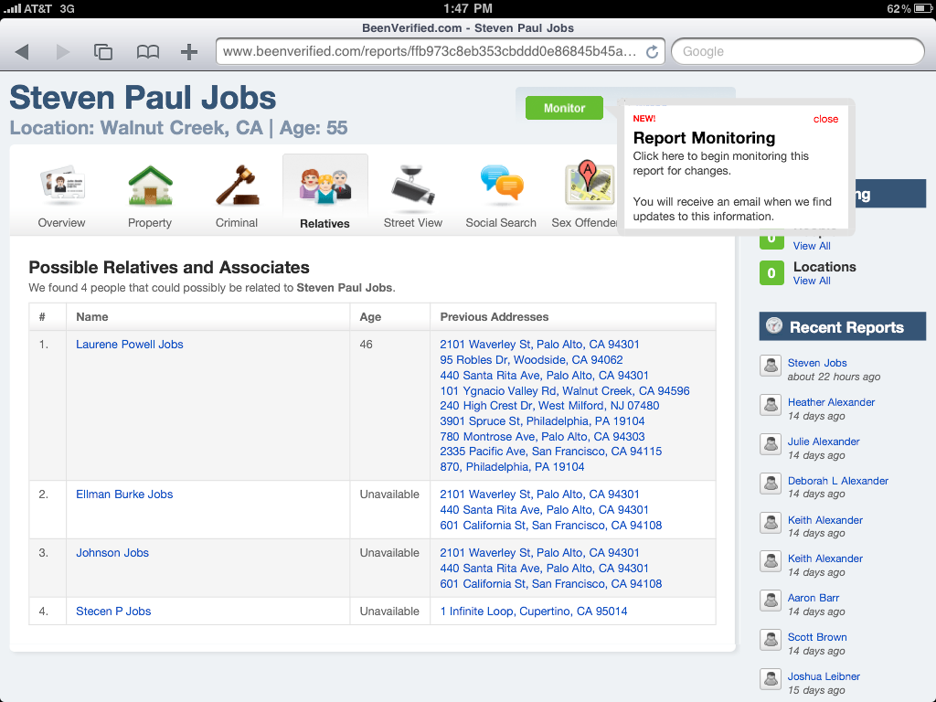
Background Search
Fills in personal history and family relationships.
Family members used for extended social media profiling.

Slide 55
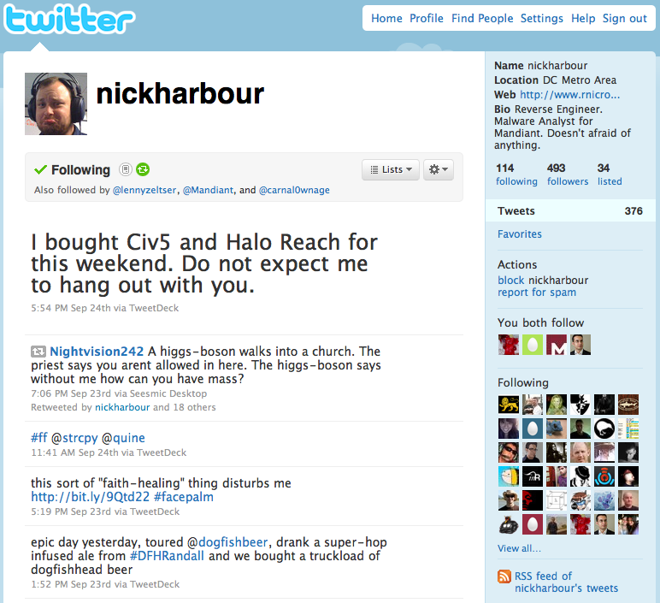
Twitter Page
Personal Info
What do they post
Who do they follow
Who follows them

Slide 56
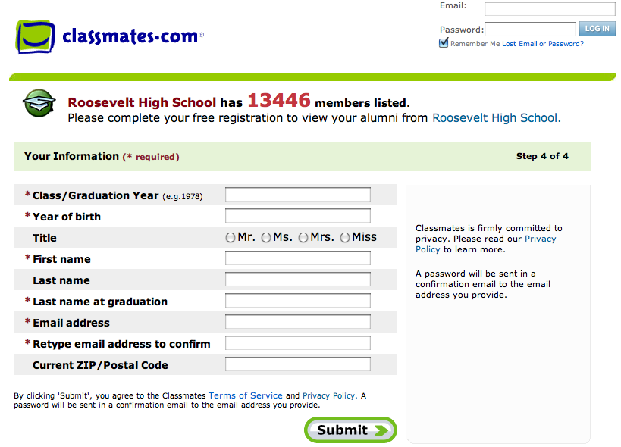
Classmates
Fills in personal history. May need to use someone from past in development of persona profiles.

Slide 57
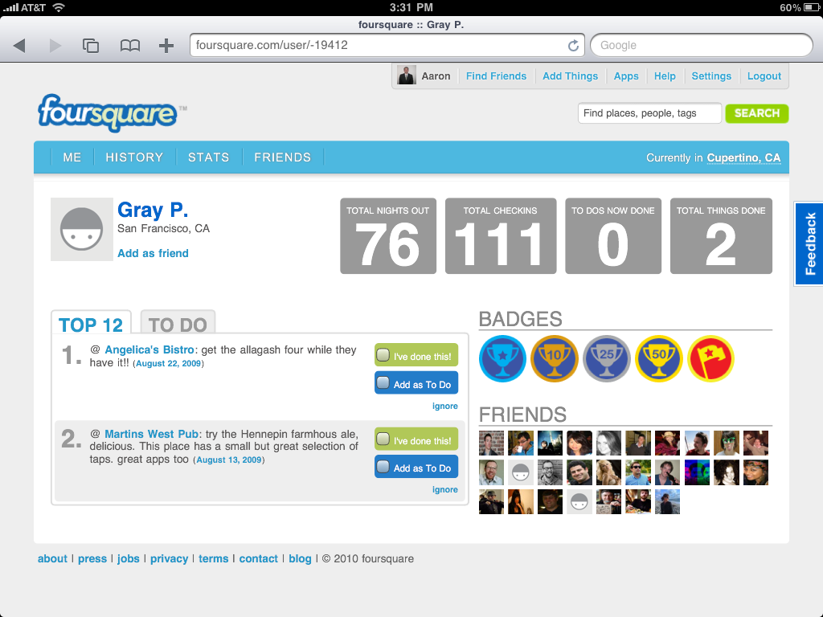
Foursquare Profile
Location information on Gray including spots he frequents most and friends.

Slide 58
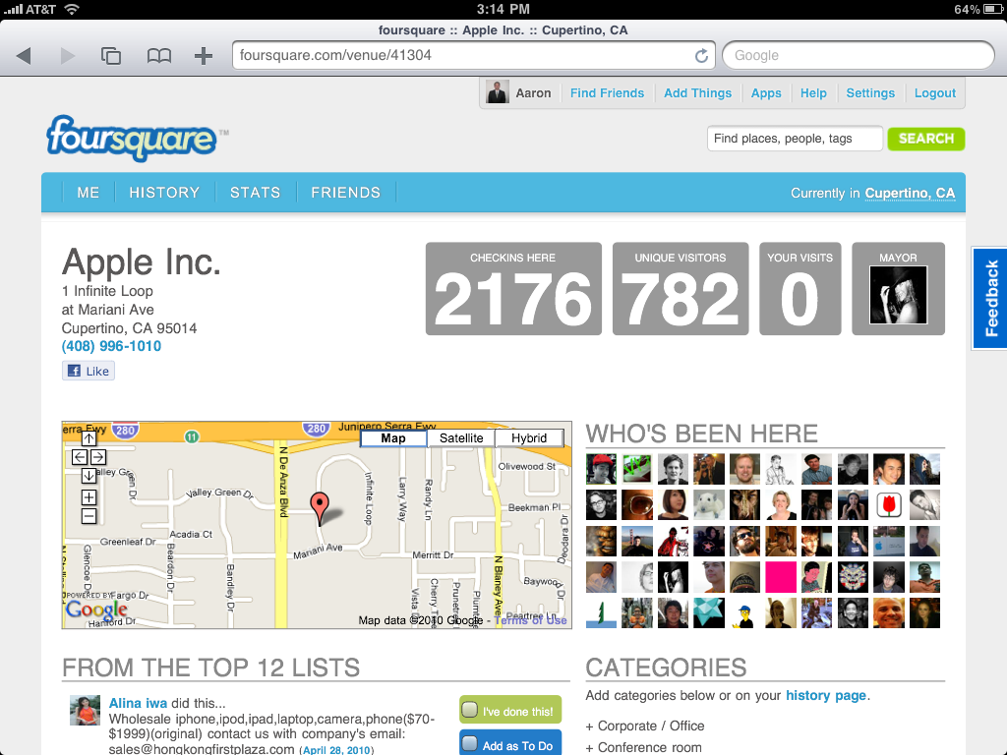
Foursquare Location
Information on Location, who frequents, tips, events.

Slide 59
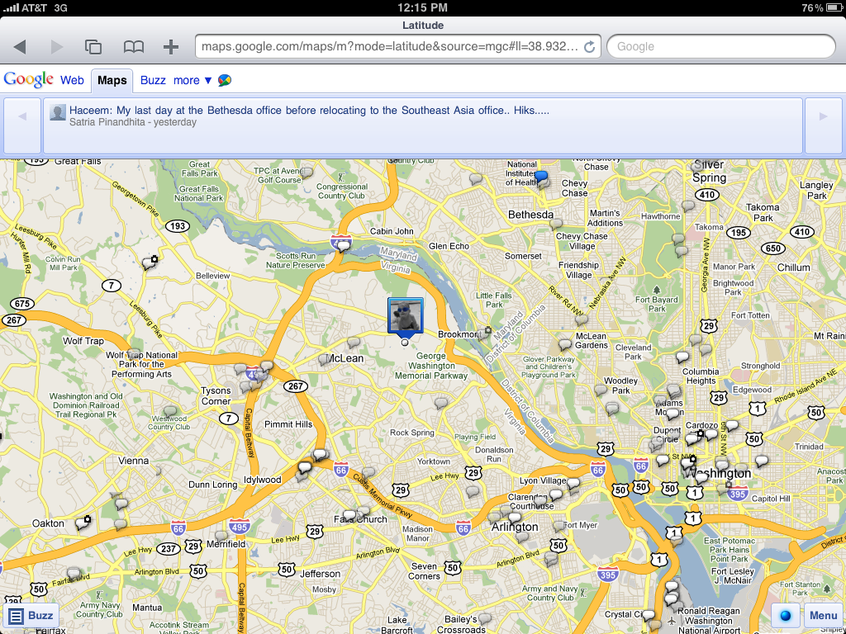
Google Buzz
Real-time location based messages using Google Buzz.

Slide 60
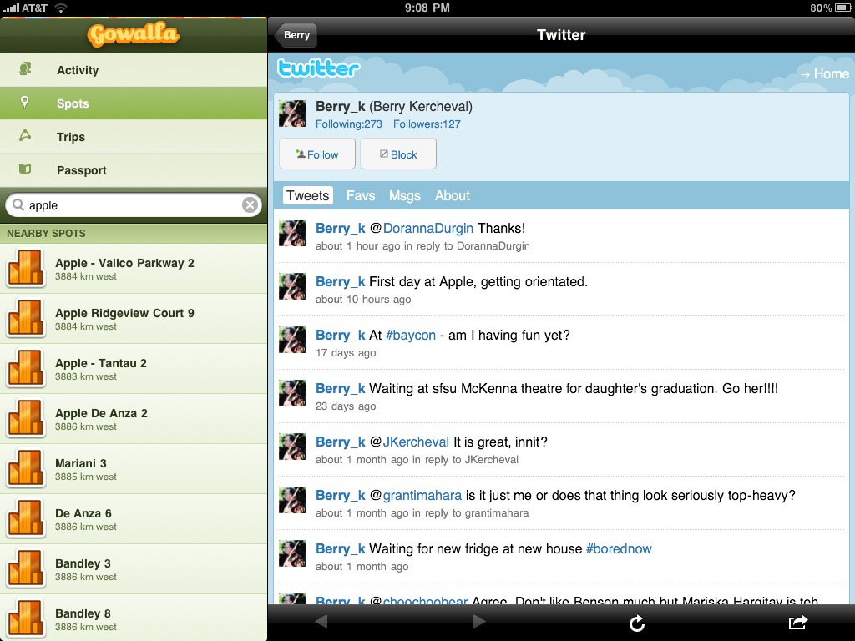
Service Integration
Twitter provides lots of good background information
Service Integration

Slide 61
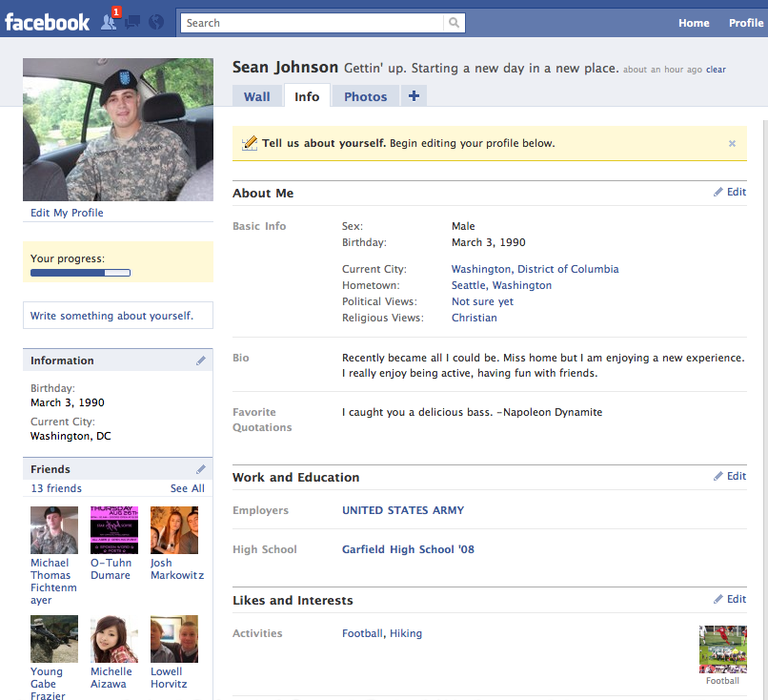
Facebook Pages
Fictitious Profile
13 friends within the first 8 hours.
Started to focus on Belvoir after 8 hours specifically INSCOM
Current friends are man army enlisted and officers including O-6 and above.

Slide 62
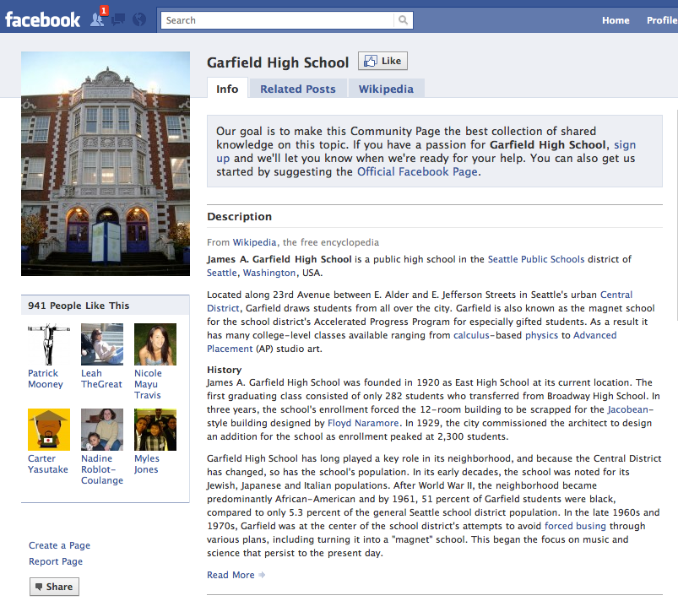
Facebook Pages
Be a little fish in a big pond.
Favor a strong online presence.
Develop characteristics that can fit within a crack of uncertainty
Start with people with lots of friends.

Slide 63
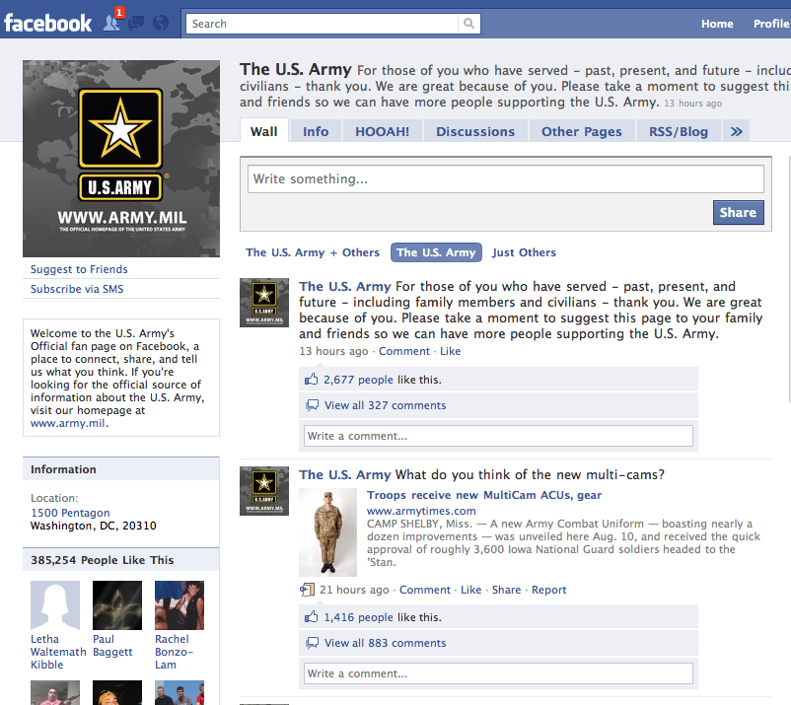
Facebook Pages
Work your way up and in. Friend people from high school to start. If not feasible start with hobbies and activities.
Also use large employers, colleges, etc.

Slide 64
Facebook Pages
Once you have built a base you can go after the more direct target.
The closer to your target the more methodical you need to be. Try and create an objectives or conversation around a friend request.

Slide 65
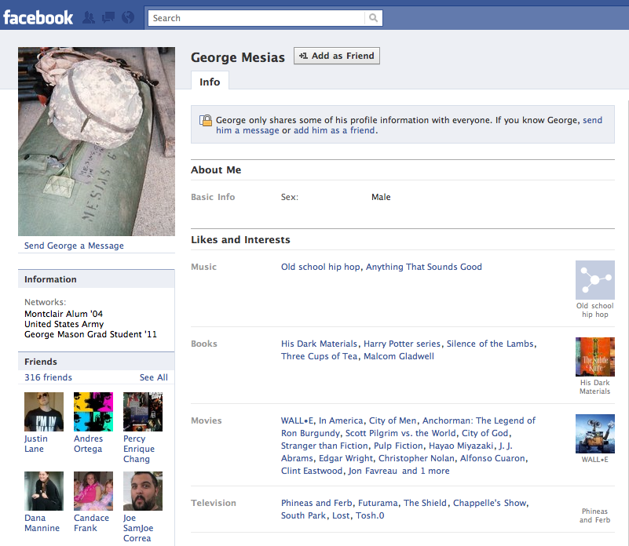
Facebook Profiles
Focus on individuals that are more promiscuous with their PII.
Lots of PII disclosure
Over 300+ friends
Nearly a sure thing George will accept a friend request.

Slide 66
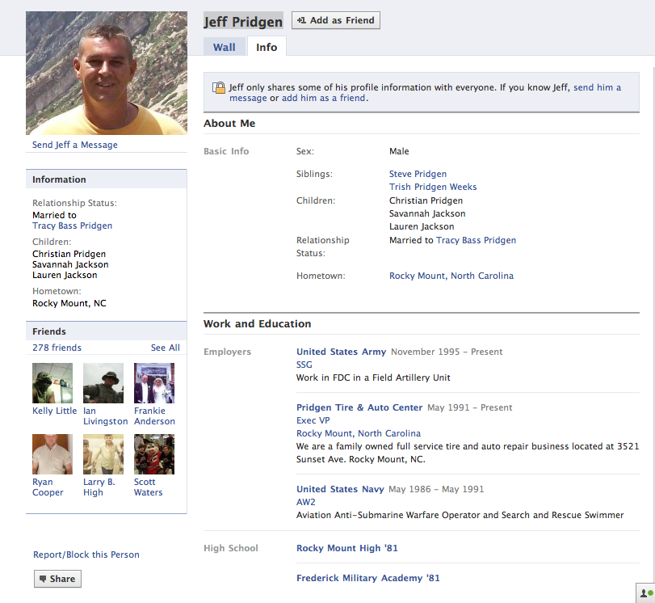
Facebook Profiles
Information from one persons profile can give you information on another.
Link analysis can provide even greater detail.
This profile let me to lots of special forces including photo shown earlier.

Slide 67
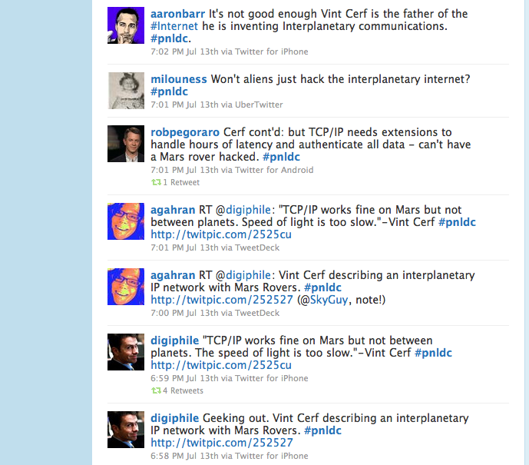
#Hashtag Jacking
Insert yourself into a localized communication stream to build a connection using shared experiences.
Could be ½ around the world.

Slide 68
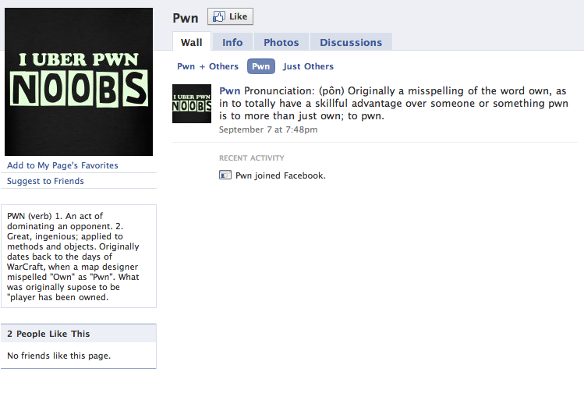
Pwn U Page
Create a page to further ground a persona, create a landing spot, deliver content

Slide 69
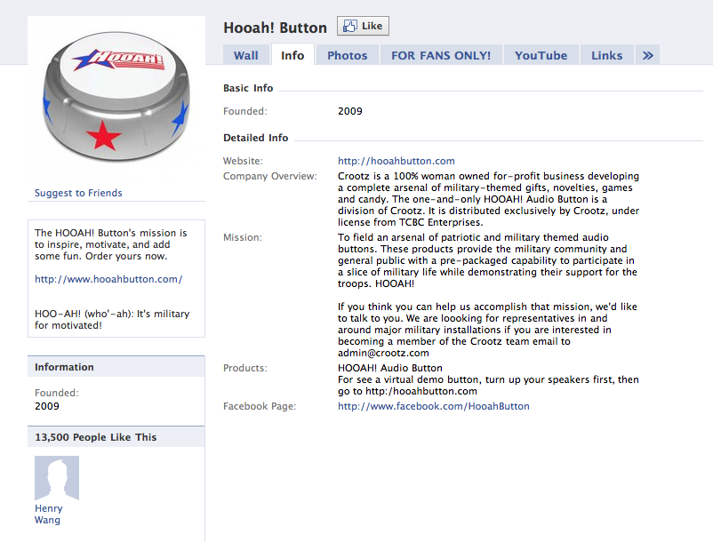
Facebook Pages
Very popular in the army currently.
Physical device has lots of extra room to fit:
GPS
Wifi
Audio
That was easy

Slide 70
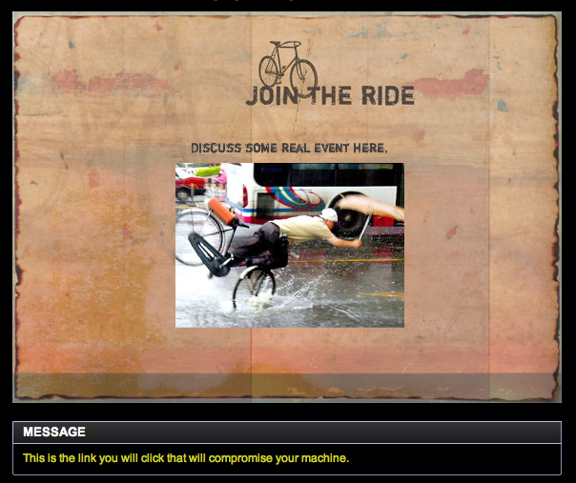
Pwn U Invitation
E-vite services allow you to create creative and completely customizable e-vites with dynamic content.
Link at the bottom to malicious content

Slide 71
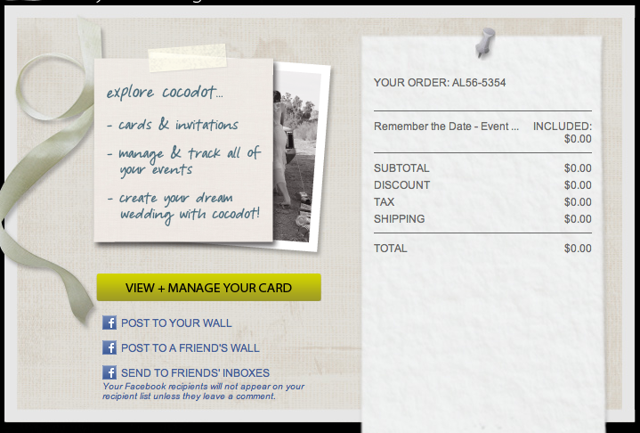
E-vite Posting Options
Fully integrated with Facebook.

Slide 72
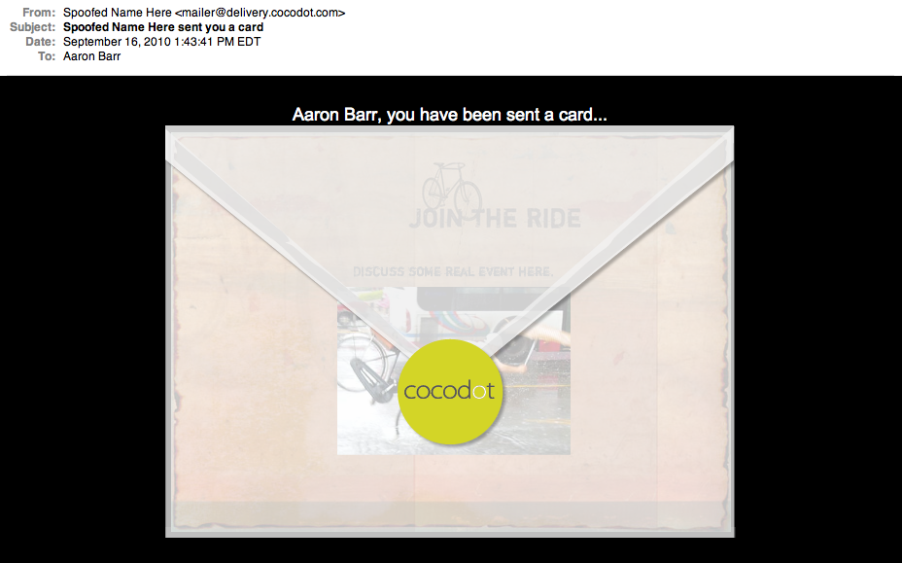
E-vite Posting Options
Send email as anyone you wish through their service.

Slide 73
Mobile Applications
Recent study showed that of 30 popular free Android applications selected at random from the Android Market that half were sending private information to advertising servers, including GPS and phone #, as frequently as every 30 sec.
Jackeey Wallpaper app (7/28/10) – wallpaper app downloaded over 1M times, collects SIM card numbers, txt msgs, subscriber ID, voicemail passwords and send to www.imnet.us, linked to Shenzen China.
Camera+ app (8/13/10) – camera app that unlocks a hidden tethering feature after visiting a specific website.
Notes:
http://www.bnet.com/2403-13070_23-219914.html

Slide 74
Words to Live By
Take Time to secure your accounts.
Be skeptical and vigilant – always.
Any account can be taken over at any time and used to collect your information, your companies information, or exploit your account or system.
You are as protected as your weakest link.
Don’t use public social media services for B2B communications unless specifically for outreach.

Slide 75
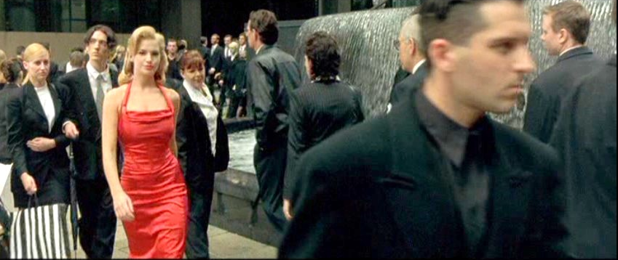
Future
Eric Arthur Blaire
Age: 44
Occupation: Author
Profile
History
Suzanna Hamilton
Age: 35
Occupation: Trainer
Profile
History
Topics
Martin Place
Sydney Australia
Opened in 1891
History
Events
Recent Visitors

Slide 76
Contact
Text “Cyber” to 90210

Slide 77
A New Age in Malware
In July 2010 a Belarus-based security company discovered a new worm on computers belonging to an Iranian client.
Targets the Siemens WinCC/PCS 7 SCADA system.
Many unique features
Most sophisticated malware ever discovered.

Slide 78
Stuxnet FAQ
4 Zero Days
2 Acquired Digital Certificates
First PLC rootkit.
Self-propagation and direction (AI).
This took a team of developers months to put together.
But that’s not the important part.

Slide 79
Stuxnet FAQ
Malware that bridges the gap between logical and physical control and manipulation.
Likely politically motivated.
Destroying power facilities, water treatment, emergency services – no longer a theory.

Slide 80
Changes Everything
In this new environment traditional capabilities are useless.
Designed for 100% chance of initial success
No C&C
Bypass existing security mechanisms
Incorporated with other resources.
Supply Chain
Human Asset

